Slide 1
K RAMAKRISHNAN COLLEGE OF TECHNOLOGY
HATE SPEECH DETECTION USING MACHINE LEARNING

Slide 2
GUIDE NAME : MRS.P.JASMINE JOSE , ME
TEAM MEMBERS:
NAME REGISTER NUMBER
1.KABILESHWARAN K 811721243022
2.MELWIN A.B 811721243027
3.MOHAMED FAIZUL S 811721243030
4.RAVIDHARSHEN M.K 811721243043

Slide 3
Objective:
Hate speech is a big problem on the internet. It can be found on social media, in comment sections, and even in online forums.
Machine learning algorithms and NLP can be used to detect hate speech on the internet by analyzing text, identifying hate speech, determining tone, and recognizing disguised hate speech in the form of jokes or sarcasm.

Slide 4
INTRODUCTION:
Hate speech detection is the task of detecting if communication such as text, audio, and so on contains hatred and or encourages violence towards a person or a group of people.
It usually based on prejudice against 'protected characteristics' such as their ethnicity, gender, sexual orientation, religion, age etc.
The automatic detection of hate speech is a challenging task due to disagreements on different hate speech definitions.
Therefore, some content might be hateful to some individuals and not to others, based on their concerned definitions.

Slide 5
EXISTING SYSTEM:
The machine learning algorithms that can be used to detect hate speech include Naive Bayes, Support Vector machines (SVM), extreme gradient boosting (XGBoost), multi-layer perception (MLP).
The hate speech data sets are usually not clean, so they need to be pre-processed before classification algorithms can detect hate speech in them. Different machine learning models have different weakness.
Traditional text classification methods based on machine learning have many disadvantages such as dimension explosion, data sparsity, limited generalization ability.

Slide 6
PROPOSED SYSTEM:
This project uses LSTM for hate speech classification.LSTM stands for Long-Short Term Memory.
LSTM is a type of recurrent neural network but is better than traditional recurrent neural networks in terms of memory.
Having a good hold over memorizing certain patterns LSTMs perform fairly better. As with every other NN, LSTM can have multiple hidden layers and as it passes through every layer, the relevant information is kept and all the irrelevant information gets discarded in every single cell.

Slide 7
LITERATURE REVIEW:
SI.NO | TITLE | AUTHOR NAME | YEAR | ALGORITHM USED | MERITS | DEMERITS
1. | Detecting Hate Speech in multi-modal Memes | Abhishek Das, Japsimar Singh Wahi, Siyao Li | 2020 | An algorithm for detecting hate speech in multi-modal memes combines visual features extracted via CNNs and text features processed with NLP models like BERT, then fuses these features using techniques like attention mechanisms before classifying them with a neural network. | Integrates both textual and visual features for hate speech detection, capturing the nuanced nature of multi-modal memes. | Integrating both text and image analysis techniques may increase computational overhead, requiring significant resources for processing large volumes of multi-modal memes.

Slide 8
SI.NO | TITLE | AUTHOR NAME | YEAR | ALGORITHM USED | MERITS | DEMERITS
2. | Social Shout -Hate Speech Detection Using Machine Learning Algorithm. | V.B. Ohol, Siddhi Patil, Ishwari Gamne, Sayali Patil, Shweta Bandawane. | 2023. | The Social Shout hate speech detection algorithm utilizes machine learning by first extracting features using NLP techniques like TF-IDF or word embeddings, and then classifying the text as hate speech or not using supervised learning models such as SVM or deep neural networks. | Firstly, by automating the identification process, it reduces reliance on manual moderation, enhancing efficiency and scalability. | Biases from training data, misclassifications, continuous adaptation needs, and computational demands pose challenges to hate speech detection algorithms.

Slide 9
SI.NO | TITLE | AUTHOR NAME | YEAR | ALGORITHM USED | MERITS | DEMERITS
3. | Deep Learning Models For Multilingual Hate Speech Detection. | Sai Saketh Aluru, Binny Mathew, Punyajoy Saha, Animesh Mukherjee. | 2022 | Deep learning models for multilingual hate speech detection typically involve using pre-trained multilingual transformers (e.g., mBERT, XLM-R) to encode text features, followed by fine-tuning these models on hate speech datasets and employing a classifier layer to detect hate speech across multiple languages. | Deep learning models can learn representations of language that generalize across different languages, enabling effective hate speech detection in multilingual contexts. | Deep learning models for hate speech detection require large amounts of annotated data in multiple languages, which may be challenging and expensive to obtain.

Slide 10
SI.NO | TITLE | AUTHOR NAME | YEAR | ALGORITHM USED | MERITS | DEMERITS
4. | A Literature Review Of Textual Hate Speech Detection Methods And Datasets | Fatimah Alkomah, Xiaogang Ma | 2022 | Textual hate speech detection methods typically involve pre-processing text data, extracting features using techniques like TF-IDF, word embeddings, or transformers, and then classifying the text using machine learning models such as SVMs, LSTM networks, or transformers, trained on annotated hate speech datasets. | The literature review offers a comprehensive summary of the state-of-the-art methods and datasets for textual hate speech detection, providing valuable insights for researchers and practitioners. | The literature review may be subject to publication bias, as it might predominantly include studies that have been published in reputable journals or conferences, potentially overlooking relevant work in gray literature or unpublished sources.

Slide 11
SI.NO | TITLE | AUTHOR NAME | YEAR | ALGORITHM USED | MERITS | DEMERITS
5. | A comparative analysis of machine learning algorithms for hate speech detection in social media | Esraa Omran , Estabraq Al Tararwah ,Jamal Al Qundus | 2023 | The comparative analysis of machine learning algorithms for hate speech detection involves pre-processing social media text, extracting features using methods like TF-IDF or word embeddings, and then evaluating various classifiers such as logistic regression, SVM, random forests, and neural networks on their performance metrics like accuracy and F1-score. | Simple, fast, and efficient with good performance on small datasets, Effective in high-dimensional spaces, memory-efficient, and versatile. | Assumes independence among features, may not perform well with correlated features.

Slide 12
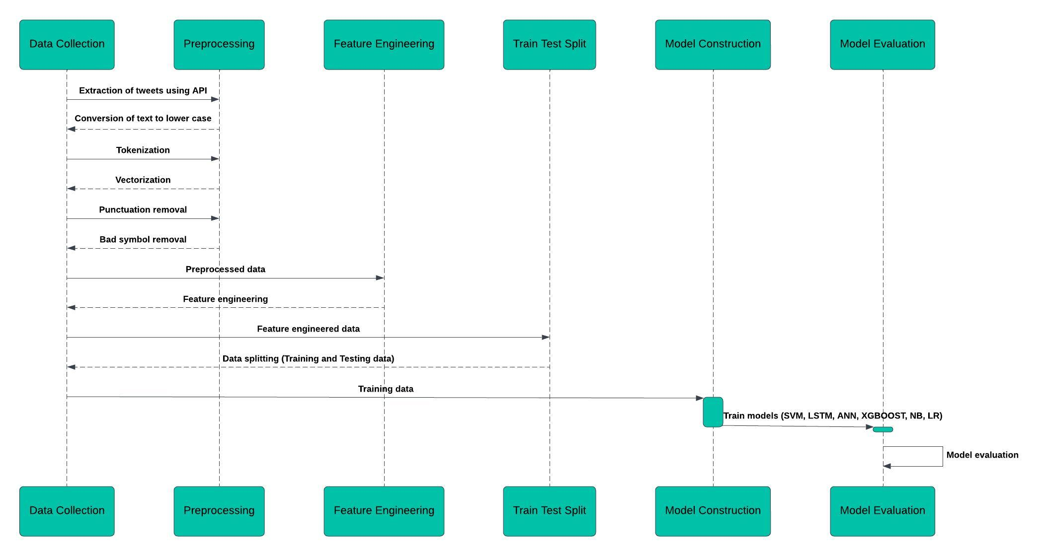
ARCHITECTURE:

Slide 13
SYSTEM REQUIREMENTS:
Software Requirements:
Python 3
Preferred IDE
Necessary Modules
Hardware Requirements:
LAPTOP WITH 8GB RAM
1 tb Hard Disk

Slide 14
MODULES:
The module are:
1.NLTK and SPACY.
2.Data gathering.
3.Data preprocessing.
4.Count vectorization.
5.Evaluation metrics.
1.NLTK and SPACY:
NLTK is a comprehensive library for natural language processing, which includes tools for tokenization, stemming, lemmatization, and more.
spaCy is a more modern and efficient library for NLP, suitable for larger datasets and production environments.

Slide 15
2.Data gathering:
Data gathering for hate speech involves collecting and analyzing textual content from various sources such as social media, forums, and news websites to identify and monitor expressions of hate.
3.Data preprocessing:
Data preprocessing for hate speech detection includes cleaning, tokenizing, normalizing, and vectorizing text data to prepare it for analysis and model training.
4.Count vectorization:
Count vectorization for hate speech detection transforms text data into numerical vectors by counting the frequency of each word in the corpus, enabling machine learning algorithms to process the textual information.
5.Evaluation metrics:
Evaluation metrics for hate speech detection include accuracy, precision, recall, F1-score, and area under the ROC curve (AUC) to assess the performance of the classification model.

Slide 16
APPLICATION:
Moderate social media for hate speech.
Filter offensive content in forums.
Ensure legal compliance in content.
Protect users from discrimination online.
Monitor news comments for civility.

Slide 17
ADVANTAGE:
Efficiently handle large volumes of data.
Ensure unbiased and consistent evaluations.
Identify hate speech in real-time.
Adapt to diverse languages and cultures.
Reduce moderation costs for platforms.
Protect user privacy during analysis.
Foster inclusive online communities.

Slide 18
CONCLUSION:
As hate speech continues to be a societal problem, the need for automatic hate speech detection systems becomes more apparent.
presented the current approaches for this task as well as a new system that achieves reasonable accuracy.
And also proposed a new approach that can out perform existing systems at this task, with the added benefit of improved interpretability.

Slide 19
REFERENCE:
A. Kamaal and M. Abulaish, ‘‘CAT-BiGRU: Convolution and attention with bi-directional gated recurrent unit for self-deprecating sarcasm detection,’’ Cognit. Comput., vol. 14, pp. 91–109, Jan. 2021.
P. K. Jain, V. Saravanan, and R. Pamula, ‘‘A hybrid CNN-LSTM: A deep learning approach for consumer sentiment analysis using qualitative usergenerated contents,’’ ACM Trans. Asian Low-Resource Lang. Inf. Process., vol. 20, no. 5, pp. 1–15, Sep. 2021.
P. K. Jain, R. Pamula, and E. A. Yekun, ‘‘A multi-label ensemble predicting model to service recommendation from social media contents,’’ J. Supercomput., vol. 66, no. 1, pp. 1–20, Sep. 2021.

